Slide 1



Farm Bill Update
Dr. Bart Fischer
Co-Director & AgriLife Assistant Professor
Agricultural & Food Policy Center (AFPC)
CFC Agri-Roots Lubbock Tour
National Ranching Heritage Center
Lubbock, TX
August 31, 2023

Slide 2
Presentation Outline
Setting the Stage
  Fiscal Responsibility Act of 2023
  Inflation Reduction Act of 2022
  2022 Cost of Production
Next Farm Bill
  Budget Realities
  Improving the Farm Safety Net
Questions…
Ag Policy

Slide 3
Setting the Stage:
Fiscal Responsibility Act of 2023

Slide 4
Fiscal Responsibility Act of 2023
What’s in it?
Suspends debt ceiling until 1/1/2025.
Generates savings of $1.5 trillion (2023–2033) relative to May 2023 baseline.
Savings largely achieved by capping FY2024 & FY2025 discretionary spending.
Claw back of unspent COVID funds reduces deficit by estimated $11 billion.
SNAP:
  Raises ABAWD age from 18-49 to 18-54; exceptions for homeless, veterans, and youth aging out of foster care; sunsets 10/1/2030.
  Lowers ABAWD exemptions from 12% to 8% and eliminates carryover.
  Publishes work waiver requests/approvals.
What’s not?
New funding for the 2023 Farm Bill! Impact?

Slide 5
Setting the Stage:
Inflation Reduction Act of 2022

Slide 6
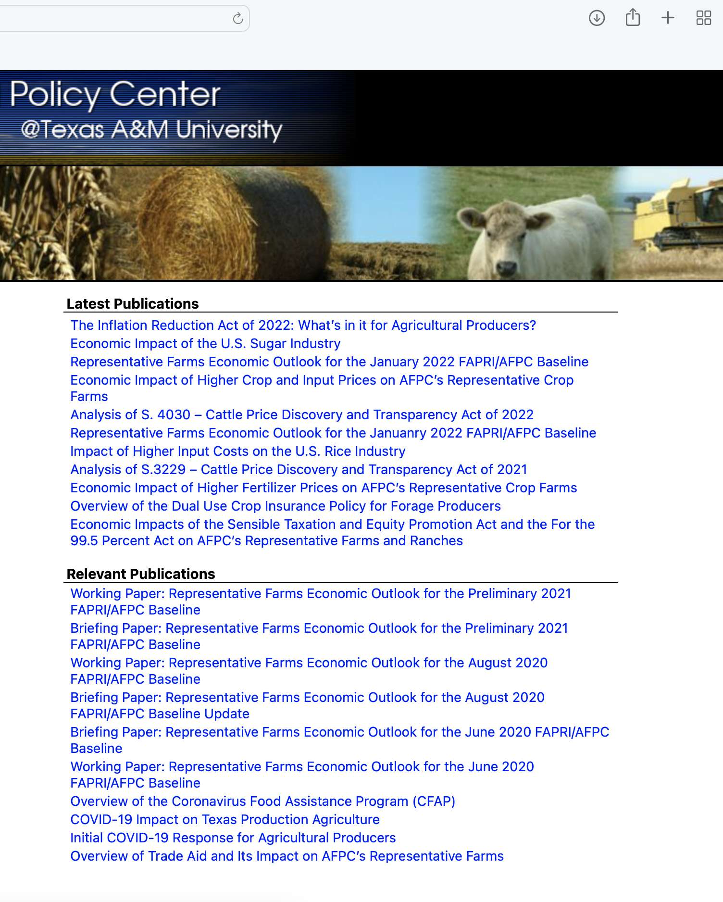
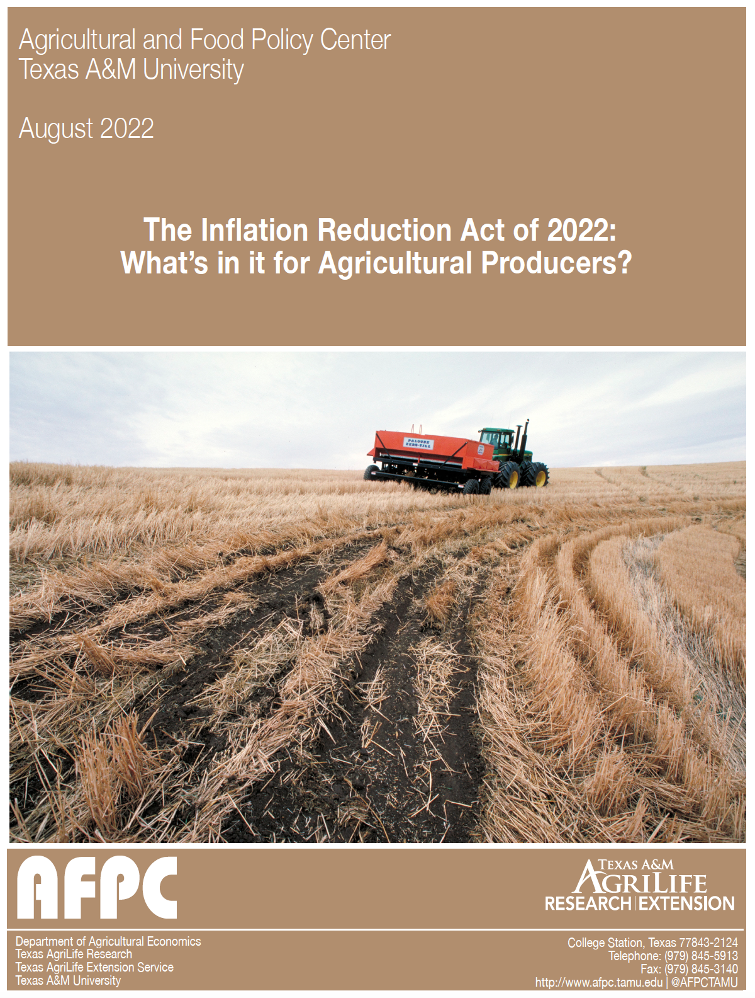
Inflation Reduction Act of 2022
www.afpc.tamu.edu

Slide 7
CBO: BBB vs IRA
Agriculture Titles (FY2022-31, Million$)

Slide 8
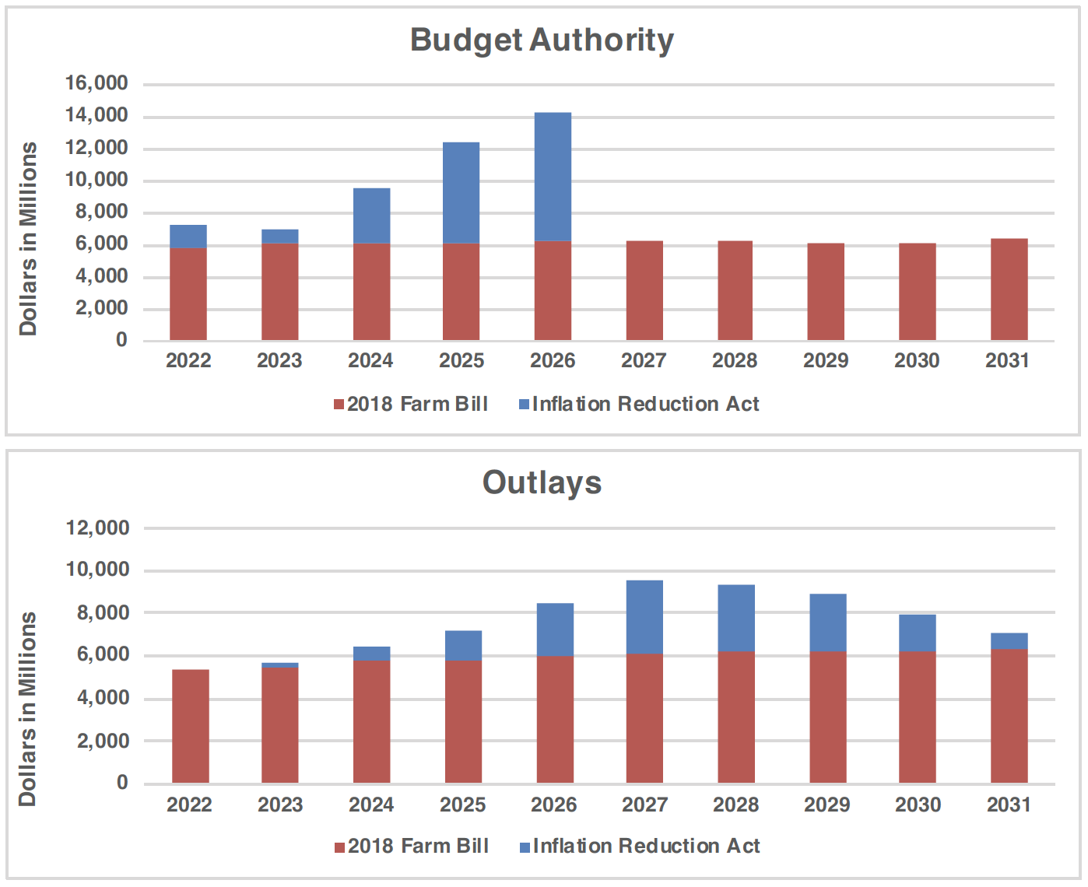
Inflation Reduction Act Baseline?
Conservation Programs

Slide 9
Setting the Stage:
Cost of Production

Slide 10
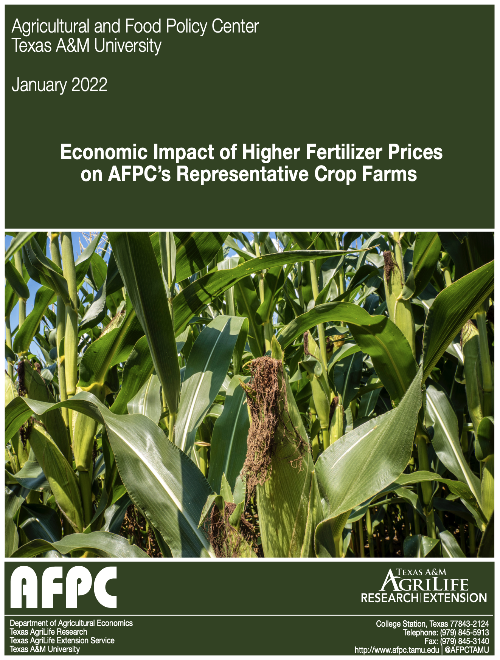
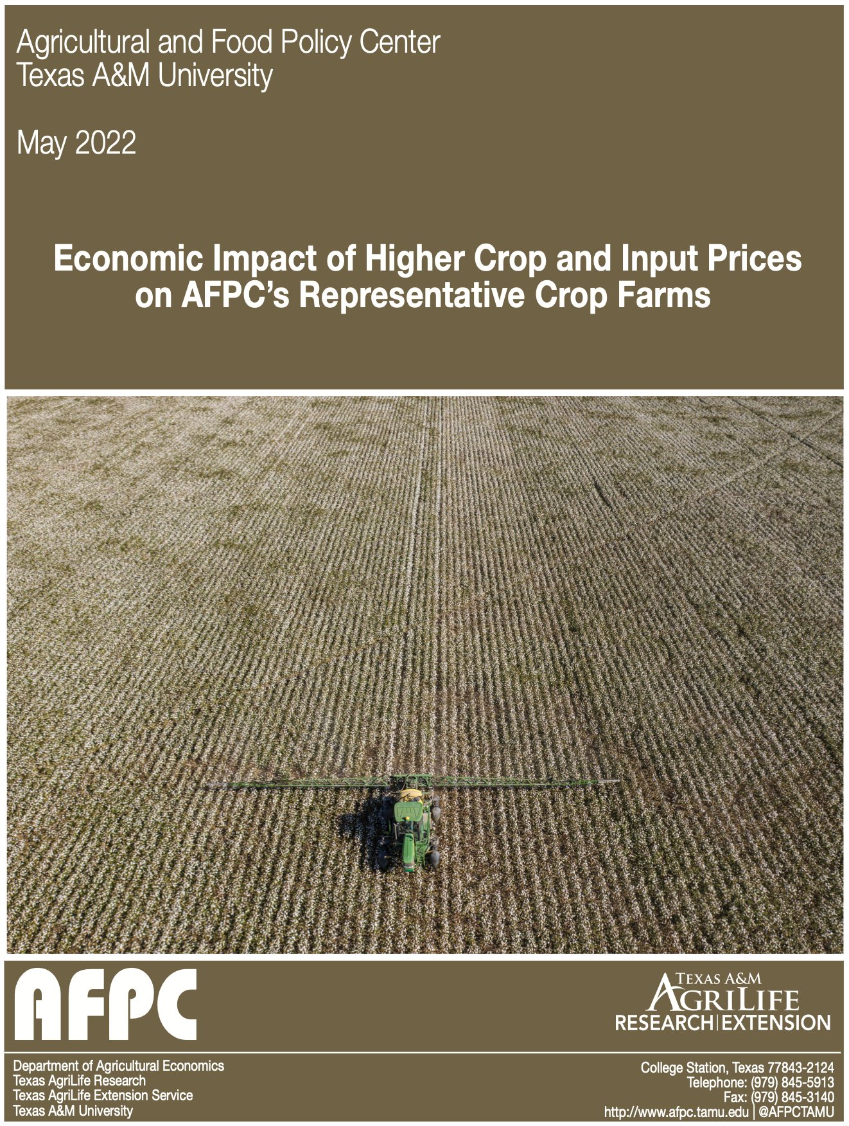
2022 Cost of Production

Slide 11
Changes in Cost of Production
USDA-ERS: 2020-22 vs. 2012-14
Source: https://southernagtoday.org/2023/06/08/adjusting-reference-prices-based-on-changes-in-cost-of-production/

Slide 12
Next Farm Bill:
Budget Realities

Slide 13
Federal Debt Held by the Public
1962-2022

Slide 14
Estimated Federal Outlays (FY2024-2033)
CBO May 2023 Baseline Outlook (in billions)

Slide 15
Farm Bill Projected Outlays
How will Congress react to a $1 TRILLION Farm Bill?
 | April 2018 | February 2023 | May 2023 | Change ($) Apr 18 v May 23 | Change (%)
CCC Price Support & Related Activities 1/ | 64,305 | 71,806 | 83,576 | +19,271 | +30.0%
Conservation 2/ | 59,689 | 72,610 | 75,124 | +15,435 | +25.9%
SNAP 3/ | 663,828 | 1,205,440 | 1,223,110 | +559,282 | +84.3%
Crop Insurance | 78,037 | 96,974 | 101,345 | +23,308 | +29.9%
Total | 865,859 | 1,446,830 | 1,483,155 | +617,296 | +71.3%
1/ This includes an estimated $10 billion in “Other Administrative CCC Spending” which accounts for CBO’s estimate of the amount that the Secretary may spend from the CCC using his/her discretionary authority.
2/ The totals for both the February 2023 & May 2023 updates includes $15.1 billion in estimated 10-year outlays for conservation spending authorized in the Inflation Reduction Act (IRA) of 2022.
3/ Revised economic assumptions and administrative changes to the Thrifty Food Plan (TFP) resulted in the Office of Management and Budget (OMB) projecting an additional $254 billion in SNAP outlays from FY2022-31 (https://www.whitehouse.gov/wp-content/uploads/2021/08/msr_fy22.pdf).

Slide 16
Select Programs Without 10 Years of Funding in the 2018 Farm Bill

Slide 17
Commodity Title Outlays
2002 vs 2018
Supplemental & Ad Hoc Disaster Assistance, including the Market Facilitation Program (FY18-23):
$93.3 billion
?
2023 Farm Bill

Slide 18
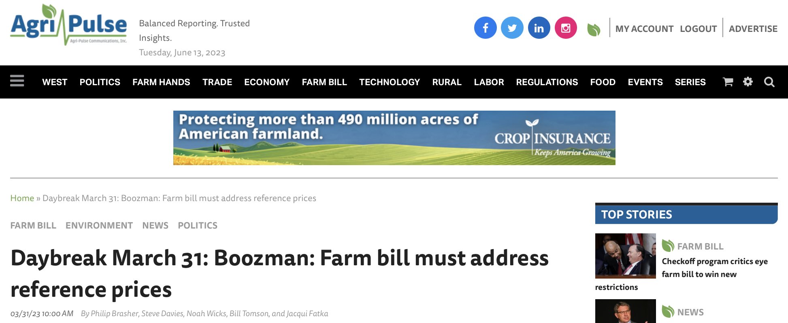
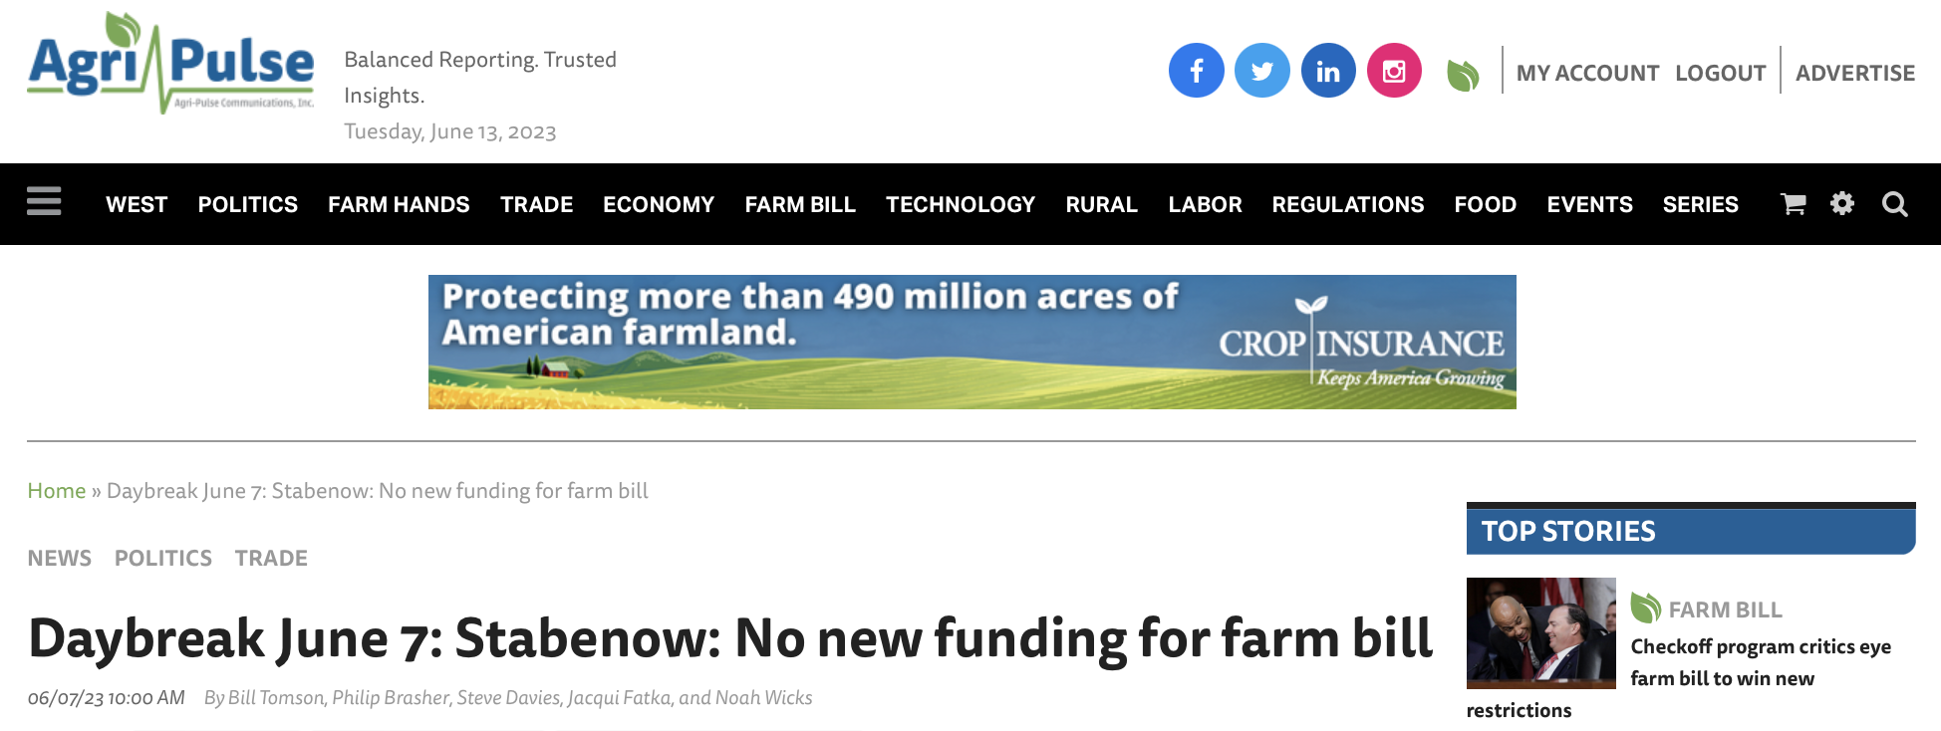
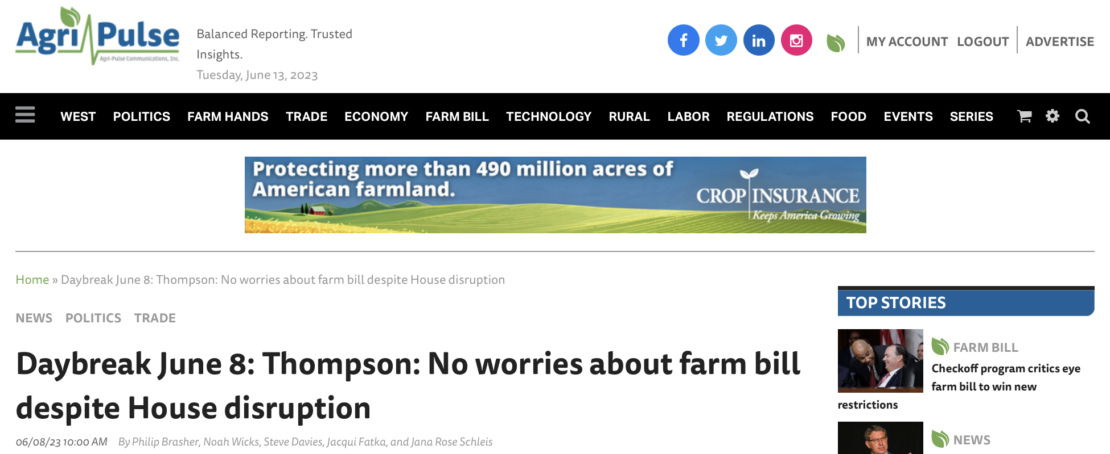
Where does that leave us?

Slide 19
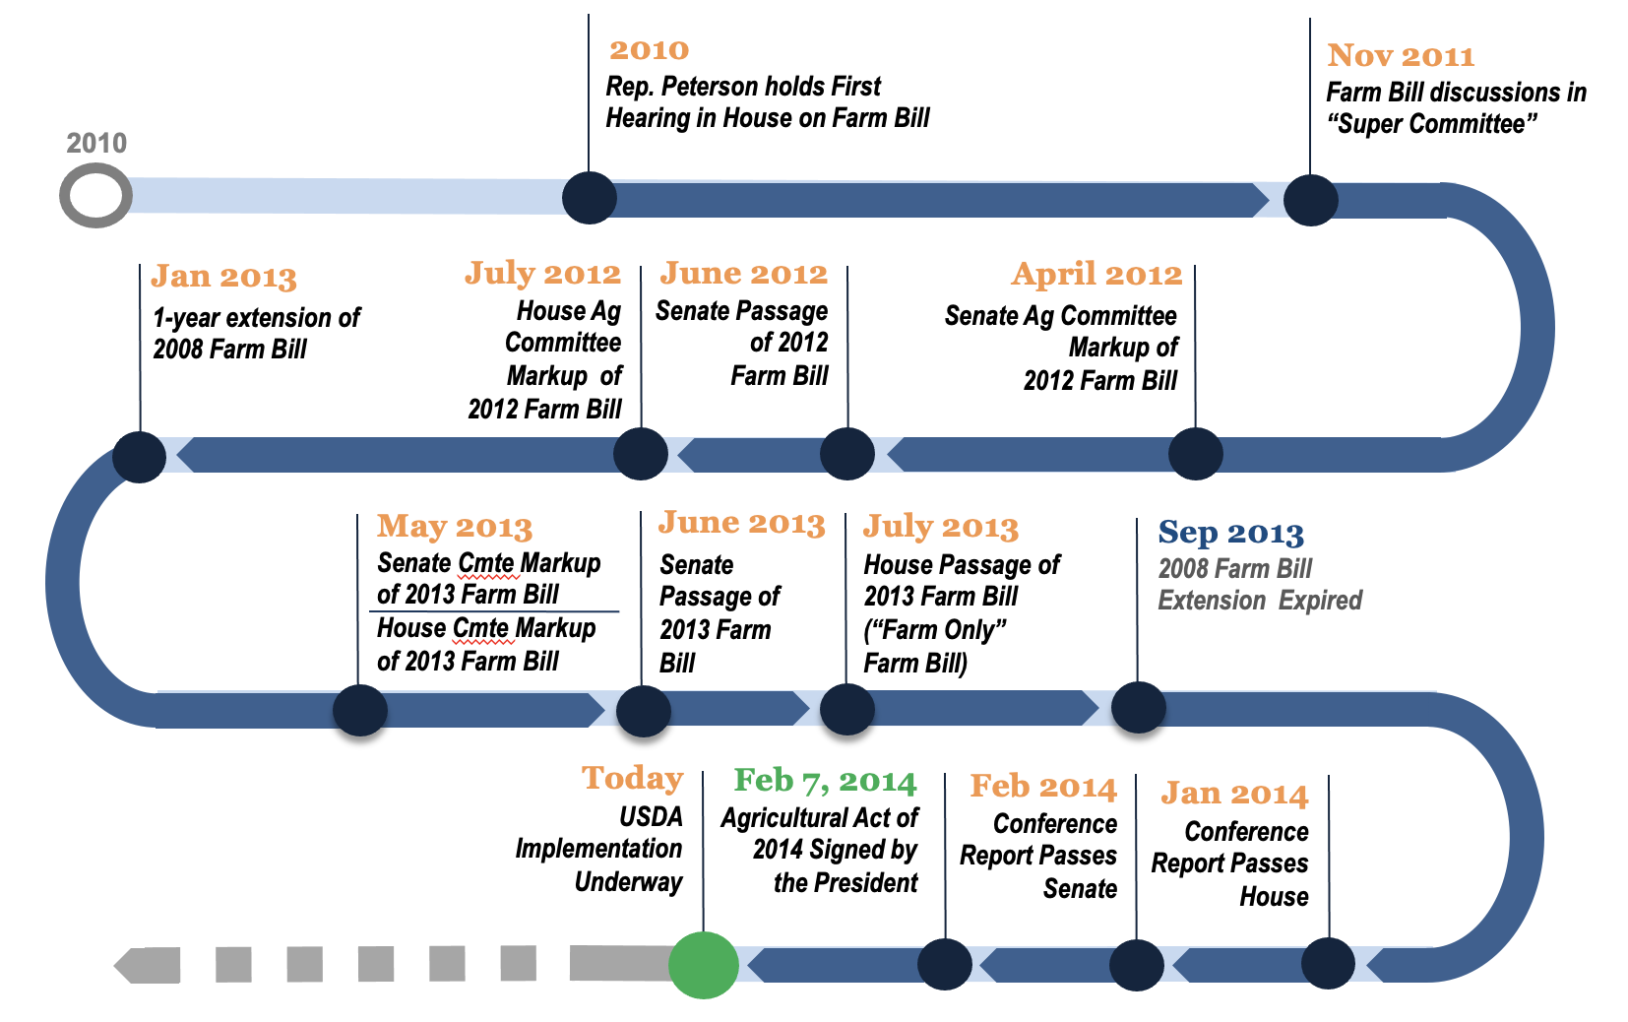
Path Forward
What’s the point of doing a new farm bill if there aren’t meaningful improvements to the farm safety net?
Pathways in the House:
  Bipartisan?
  Cuts to SNAP to
  navigate scoring
  requirements in
  new House Rules?

Slide 20
Next Farm Bill:
Improving the Farm Safety Net

Slide 21
Reference Prices
Statutory Reference Prices Set By Congress
Effective Reference Price Can Move Up If Prices Move Up
  85% of the Olympic average price for the 5 most recent completed crop years but capped at 115% of the statutory reference price [NOTE: USDA lagged by one year.]
  Given the 85% factor in the escalator calculation, average market price during the calculation window must exceed the statutory reference price by more than 15% for the escalator to increase the reference price.
Cost to increase?
  10%: ~25$ billion
  20%: ~$55-60 billion
  30%: over $100 billion

Slide 22
Effective Reference Prices
Using CBO’s May 2023 Outlook

Slide 23
Other Reference Price Inflators?
Prices Paid, Interest, Taxes, Wages (PPITW) vs. Consumer Price Index (CPI)

Slide 24
Commodity Title Specifics
Loan Rates for Nonrecourse Marketing Assistance Loans
2014 Farm Bill 2018 Farm Bill
Wheat $2.94/bu $3.38/bu
Corn $1.95/bu $2.20/bu
Grain Sorghum $1.95/bu $2.20/bu
Barley $1.95/bu $2.50/bu
Oats $1.39/bu $2.00/bu
Long Grain Rice $6.50/cwt $7.00/cwt
Med. Grain Rice $6.50/cwt $7.00/cwt
Soybeans $5.00/bu $6.20/bu
Other Oilseeds $10.09/cwt $10.09/cwt
Peanuts $355/ton $355/ton

Slide 25
Commodity Title Specifics
Loan Rates for Nonrecourse Marketing Assistance Loans
2014 Farm Bill 2018 Farm Bill
Dry Peas $5.40/cwt $6.15/cwt
Lentils $11.28/cwt $13.00/cwt
Small Chickpeas $7.43/cwt $10.00/cwt
Large Chickpeas $11.28/cwt $14.00/cwt
Honey $0.69/lb $0.69/lb
Graded Wool $1.15/lb $1.15/lb
Nongraded Wool $0.69/lb $0.40/lb
Mohair $4.20/lb $4.20/lb
Upland Cotton $0.45 to $0.52/lb $0.45 to $0.52/lb

Slide 26
Base Acres
Mandatory base update? Corn Baseline: $26.39/ac; Soybean Baseline: $11.46/ac; Likely saves money but at what expense?
Voluntary base update? Show me the money!
Rolling 5-year average? NFU 2014 proposal
Base trading or renting? 1960s & 1970s concepts
Expand/relax ineligible acres from 2018 Farm Bill?
Expand/relax Unassigned Base Acres from Bipartisan Budget Act of 2018?

Slide 27
Recap: Means Testing, Actively Engaged Rules & Payment Limits
Means Testing: participation continues to be limited to persons or entities with less than $900,000 in average adjusted gross income (AGI).
Actively Engaged Rules: the 2018 Farm Bill amends the definition of family to include first cousins, nieces, and nephews, thereby exempting them from the requirements for non-family operations authorized in the 2014 Farm Bill.
Payment Limits: maintains the current payment limitation of $125,000 in assistance from ARC/PLC per person or entity. The separate limit for peanuts is maintained and doubling for spouses continues to apply. The 2018 Farm Bill removes Loan Deficiency Payments (LDPs) and Marketing Loan Gains (MLGs) from counting toward the payment limit.

Slide 28
Means Testing, Actively Engaged Rules & Payment Limits
Lessons learned from WHIP+ & ERP?
  Update Title 1 payment limit to include ad hoc limits?
  Expand payment limits using 75% AGI threshold (i.e. if 75% of your AGI is from farming/ranching/etc)?
  Update AGI test to include 75% threshold?

Slide 29
Combine Area-Wide Insurance?
There is a confusing plethora of area-wide policy options (e.g., SCO, STAX, ECO).
Each have their own unique features—for example:
Could we take the best features of each and combine? With cotton contributing the most baseline, could STAX+PLC be allowed as a compromise? What is the future of ARC?
 | SCO | STAX | ECO
Maximum Trigger Point | 86% | 90% | 95%
Maximum Coverage | 36% | 20% | 9%
Premium Subsidy | 65% | 80% | 44% - 51%
Yield Basis | Individual APH | County Average | Individual APH
Title 1 Interaction | PLC Allowed ARC Not Allowed | PLC Not Allowed ARC Not Allowed | PLC Allowed ARC Allowed

Slide 30
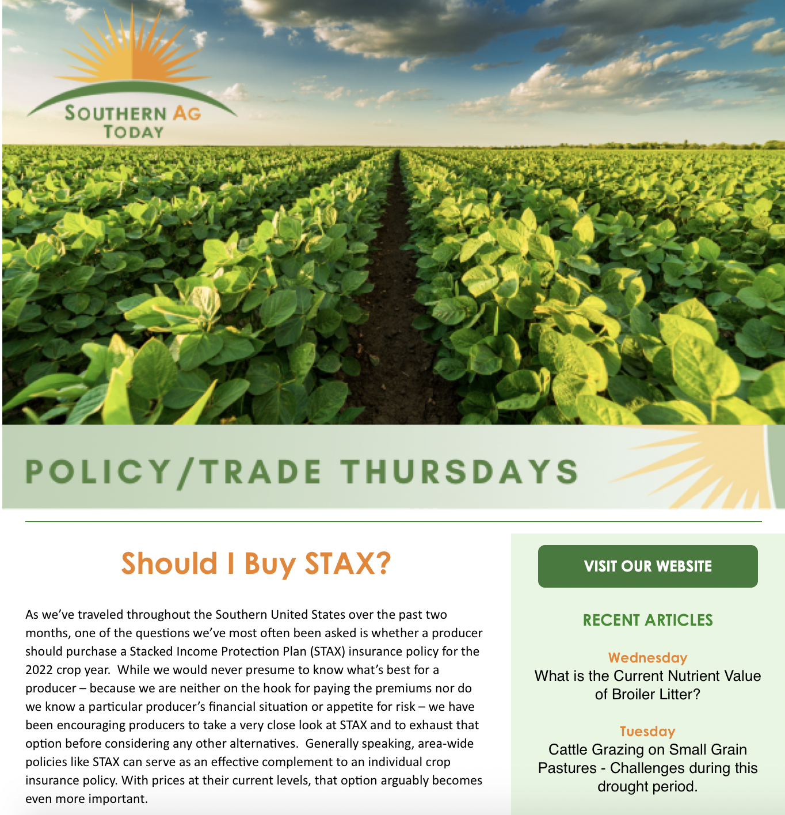

Southern Ag Today www.southernagtoday.org
Officially
launched!!

Slide 31
Questions?
Dr. Bart Fischer
bartfischer@tamu.edu
979-845-5913
www.afpc.tamu.edu

